Slide 1
Image
Feature Map
kernel
*
=
3*3
6*6*3
4*4

Slide 2
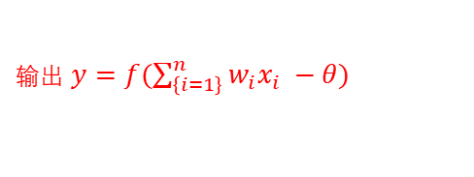
第i个神经元的输入
x
当前神经元
x1
w1
输出 $y=f(\sum_{\left\{i=1\right\}}^{n}{w_{i}x_{i} −θ})$
x2
w2
...
...
wi
θ
xi
wn
xn
阀值
第i个神经元连接的权重

Slide 3
x1
x2
x3
x4
Y

Slide 4
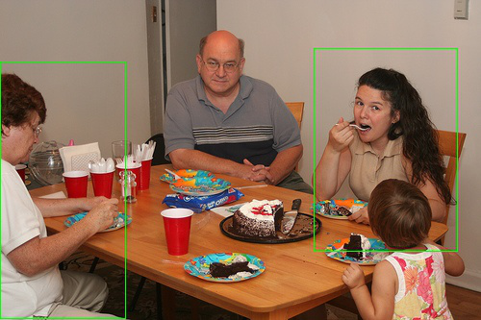
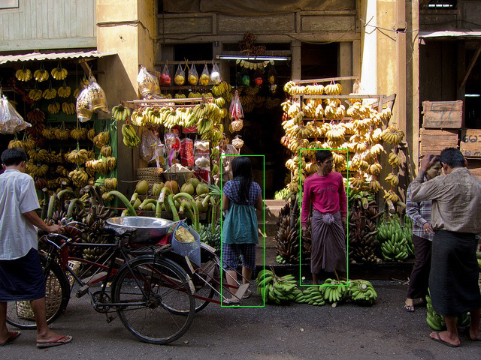
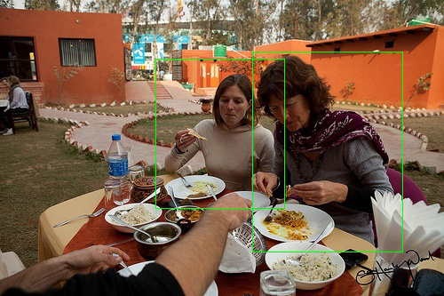
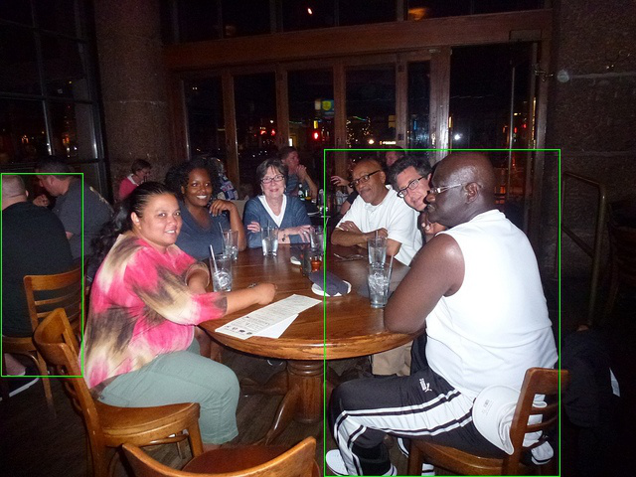
家庭关系
商业关系
朋友关系
无关系

Slide 5

X={$x_{1},x_{2},x_{3}…..,x_{4}$}

Slide 6










$S$
S
$s_{t−1 }$
$$h_{t−1}$$
$s_{t}$
$$h_{t}$$
$s_{t+1}$
$$h_{t+1}$$
$$x_{t−1}$$
$$x_{t}$$
$$x_{t+1}$$

Slide 7

人对特征抽取模块
PPRN
PPRN score
Atten weights
score
PPRN
$$⊕$$
PPRN
物体特征抽取模块

Slide 8
物体前后景分类
Roi Pooling
18
reshape
Softmax
proposal
1x1
36
检测框回归
1x1

Slide 9
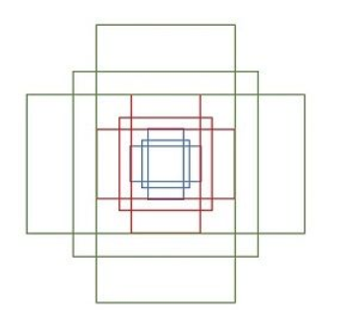

Slide 10
father-child,
mother-child,
Grandpa-grandchild
grandma-grandchild
Attachment domain (d0)
Reciprocity domain (d1)
friends, siblings and classmates
Mating domain (d2)
lovers/spouses
presenter-audience
teacher-student
trainer-trainee
leader-subordinate
Hierarchical power domain (d3)
band members,
dance team members,
sport team members
colleagues
Coalitional groups domain (d4)

Slide 11
